Slide 1
Objectives
In this session, you will learn to:
  Understand the basic concepts of TCS
  Enable TCS in Tally.ERP 9
  Create masters necessary for TCS transactions.
  Record TCS transactions
  Generate TCS reports and challans in Tally.ERP 9
Notes:
Share the session objectives with the students.

Slide 2
Basic Concepts of TCS
Tax Collected at Source means tax being collected from the source by the seller (collector) from the buyer (collectee or payee) for goods traded u/s 206C (1) of the Income Tax Act, 1961.
It is collected when accrued or when paid whichever occurs earlier.
It is prescribed for any business or trade dealing with alcoholic liquor, forest produce and scrap.
In addition, it includes lease, license or contract related to parking lots, toll plaza, mines and quarry, as defined in Section 206C of the Income Tax Act, 1961.

Slide 3
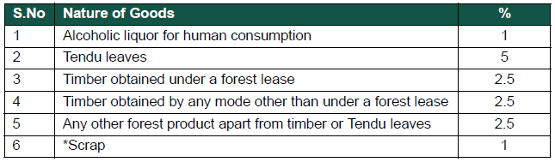
Basic Concepts of TCS (Contd.)
TCS Nature of Goods:
  The Nature of Goods covered under TCS and the rate applied thereon is described, as shown in the following figure.

Slide 4
Basic Concepts of TCS (Contd.)
Seller:
  A seller can refer to any one of the following:
    The Central Government
    A State Government
    Any Local Authority
    Corporation or Authority established by or under a Central, State or Provincial Act
    Any Company
    Firm
    Co-operative Society

Slide 5
Basic Concepts of TCS (Contd.)
Buyer:
  Is a person who has the right to receive or obtain goods by means of a sale, auction, tender or any other mode.
  Does not include:
    A public sector company
    The central government
    A state government
    An embassy
    A high commission
    Legation
    Commission
    Consulate and the trade representation of a foreign state
    A club
    A buyer in the retail sale of such goods purchased by him for personal consumption

Slide 6
TCS on Contracts, License and Leases
According to Sec 206C (1C), Other than a public sector company (licensee or lessee), every person while dealing with another person for business, in whole or in part, either:
  Grants a lease or license
  Enters into a contract
  Transfers any right or interest

Slide 7
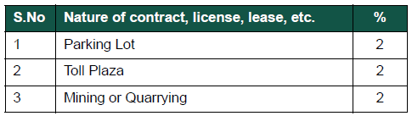
TCS on Contracts, License and Leases (Contd.)
The TCS is collected from the licensee at the rates are specified, as shown in the following figure.

Slide 8
Time and Mode of Payment
The total amount collected is paid to the Central Government within a week from the last day of the month.
The collection when made by or on behalf of the Government, results in the amount being credited without the production of a challan.

Slide 9
Credit for Tax Collected at Source
The amount collected on behalf of a person and paid under Section 206C(3) to the Central Government, and specified in the second provision to sub-section (5) shall be deemed as payment of tax.
Credit shall be given for that amount, for the assessment year in which such income is assessable without the production of a certificate.

Slide 10
Issue of TCS Certificate
The person collecting tax, issues a certificate
(Form No. 27D) to the buyer stating the tax collected at source.
This is issued within a month of the amount being debited to the account of the buyer or the payment received from the buyer subject to the following clauses:
  Provided that no certificate is furnished for the tax collected on or after 1-4-2005
  Provided that the income-tax authority or the authorised person issues Form No. 26AS specifying the amount of tax collected to the buyer or to the licensee or lessee, within the prescribed time at the end of each financial year

Slide 11
Issue of Consolidated Certificate
Some times, a buyer requires multiple certificates as proof of the tax collected at source for the period ending on 30th September and 31st March, in each financial year.
In such cases, the person collecting the tax, can on request, issue a consolidated certificate (Form No. 27D) within a month.

Slide 12
TCS Returns
To ensure proper checks on the collections (TCS) and subsequent credit taken by the collectee or payee, the collectors are required to file their TCS returns with the Income Tax Department.
The TCS returns contain the following information in the form prescribed by the Income Tax Department:
  Collector details (the TAN, Name, Address)
  The bank where the tax is deposited (like the amount, challan identification number)
  The collectee details (the PAN, Name, Amount paid, Tax collected at source)

Slide 13
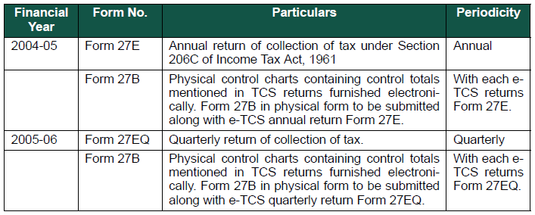
TCS Returns (Contd.)
The revised forms for e-TCS returns and periodicity thereof prescribed under income tax laws are displayed, as shown in the following figure.

Slide 14
Configuring Tally.ERP 9 for TCS
Tally.ERP 9’s TCS feature enables you to record transactions related to Tax Collection at Source with ease.
It also helps you generate the necessary reports and returns:
  Form 27D
  e-TCS Forms (Form 27E, Form 27EQ)
  Form 27B

Slide 15

Demo: Configuring Tally.ERP 9 for TCS
Let us see how to configure Tally.ERP 9 for TCS.

Slide 16
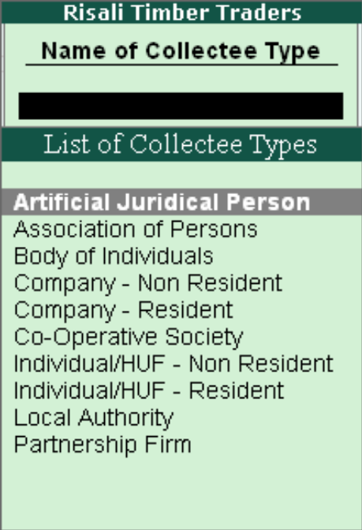
TCS Statutory Masters
List of Collectee Types:
  The buyers (customers) covered under TCS have to be identified with a Collectee Type.
  The list of Collectee Types, is displayed, as shown in the following figure.

Slide 17
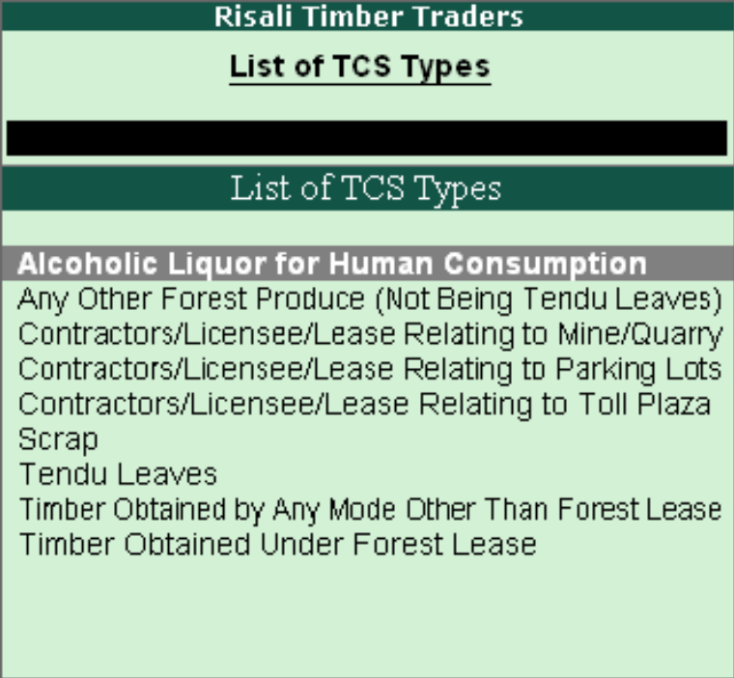
TCS Statutory Masters (Contd.)
The List of TCS Types:
  The transactions covered under TCS are grouped under the List of TCS Types, as shown in the following figure.

Slide 18
Creating Masters
The following masters are required to generate information on the TCS:
  Party Ledger
  TCS Ledger
  Sales Ledger
  Timber as Stock Item

Slide 19
Demo: Creating Masters
Let us create masters required to generate information on TCS in Tally.ERP 9.

Slide 20
Demo: Entering Transactions
Problem Statement:
  Creating Sales:
    On 9-4-09, sold 250 MT of Timber to Bhima Timbers @
    Rs. 1,250/MT with TCS. The Freight charges are Rs. 1,500.

Slide 21
Demo: Entering Transactions (Contd.)
Solution:
  To enter the preceding transaction in Tally.ERP 9, you need to perform the following tasks:
    Create Sales Voucher
    Create Payment Voucher to record the payment of TCS

Slide 22
Challan Reconciliation
The challan particulars can be reconciled with the payment made in their respective TCS ledgers.

Slide 23
Demo: Reconciling TCS Ledger
Let us see how to reconcile TCS Ledger in Tally.ERP 9.

Slide 24
TCS Reports
Tally.ERP 9 provides the following TCS Forms and Reports:
  Form 27D
  Form 27E (eTCS Forms)
  Form 27EQ (eTCS Forms)
  Form 27B

Slide 25
e-TCS Returns
e-TCS is the filing of TCS returns using electronic media.
It is mandatory for corporate and government collectors to furnish TCS returns in electronic form, from financial year 2004-2005.
Collectors (other than government and corporates) may file TCS returns in electronic or physical form.
NSDL collects the e-TCS returns from the Collectors on behalf of the Income Tax Department.
Deductors furnishing their e-TCS have to furnish:
  Form 27B as a control chart
  A CD or Floppy containing the e-TCS annual return (Form 27E)

Slide 26
Summary
In this session, you learned that:
  TCS refers to the collection of tax at source by the seller (collector) from the buyer (collectee or payee) for the trade of goods specified u/s 206C (1) of the Income Tax Act, 1961.
  The term ‘Seller’ refers to the Central Government, a State Government, any local authority, Corporation or authority established by or under a Central, State or Provincial Act, any Firm or Co-operative society.
  The term ‘Buyer’ refers to a person who obtains goods from any sale, auction, tender, or any other mode.
  TCS collected shall be paid to the credit of the Central Government within one week from the end of the month in which the collection is made.

Slide 27
Summary (Contd.)
  To ensure proper checks and balances on TCS collections and subsequent credit taken there of by the collectee or payee, the collectors are required to file TCS returns with the Income Tax Department.

